Slide 1
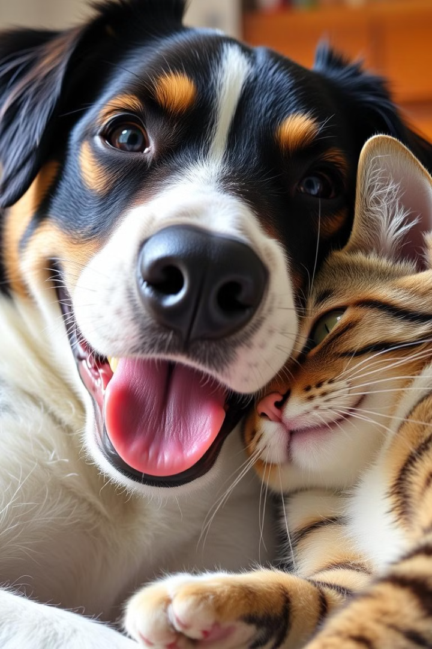

AniWel: A Compassionate Animal Welfare Website
This presentation showcases the design and development of AniWel, a website dedicated to animal welfare and services. It features a user-friendly interface and provides a comprehensive overview of the organization's mission and offerings. The presentation delves into the key features and functionalities of the site, highlighting its key elements and design considerations.
by Niharika

Slide 2
Introduction
AniWel is a non-profit organization committed to enhancing animal welfare. It provides a platform for connecting people with animal services, sharing information about animal care, and raising awareness about animal rights.
The website serves as a central hub for animal lovers, offering a range of resources and information to improve the lives of animals in our community.

Slide 3
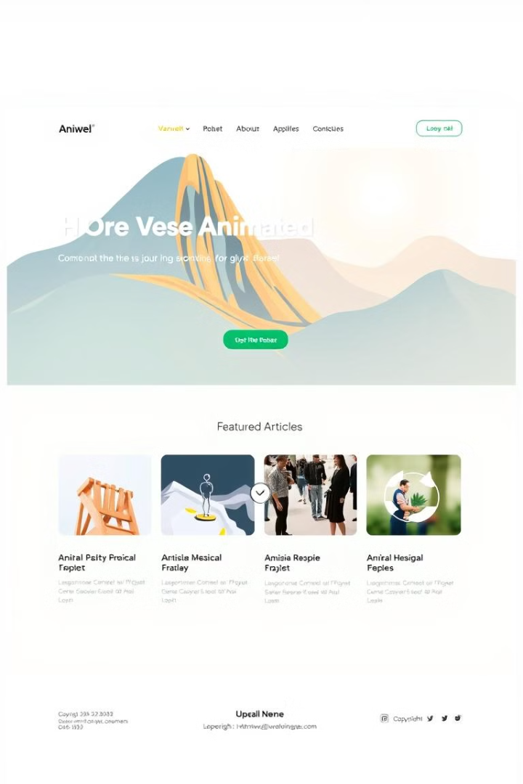
Home Page
1
Key Features
2
Mission and Values
A visually engaging and informative homepage with a clear call to action.
A concise statement outlining the organization's core beliefs and commitment to animal welfare.
3
Featured Stories
4
Upcoming Events
Highlighting heartwarming stories of animals in need and successful adoption outcomes.
Promoting awareness of upcoming events, fundraisers, and volunteer opportunities.

Slide 4

About Us
Our History
Our Team
A brief history of AniWel, highlighting its founding principles and milestones.
Showcasing the dedicated team members who contribute to AniWel's success.
Our Impact
Our Vision
Illustrating the positive impact AniWel has made on animals and the community.
A clear vision for the future of AniWel, outlining its long-term goals and aspirations.

Slide 5

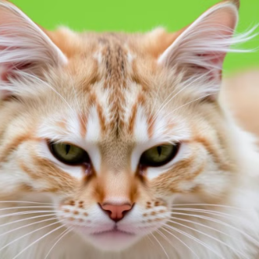
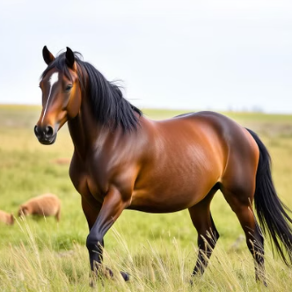
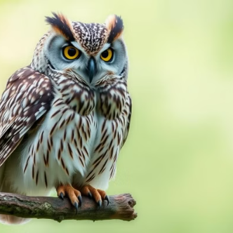

Gallery of Photos

Slide 6
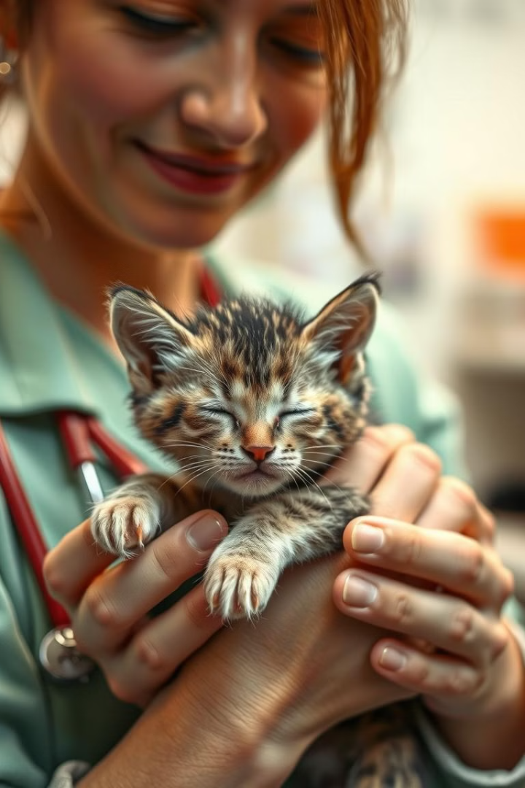




Our Services
Adoption
Veterinary Care
A platform for connecting animals in need with loving homes.
Providing affordable and accessible veterinary services for animals.
Donation
Volunteer Opportunities
Enabling individuals to contribute financially to AniWel's mission.
Offering opportunities for individuals to get involved and make a difference.

Slide 7
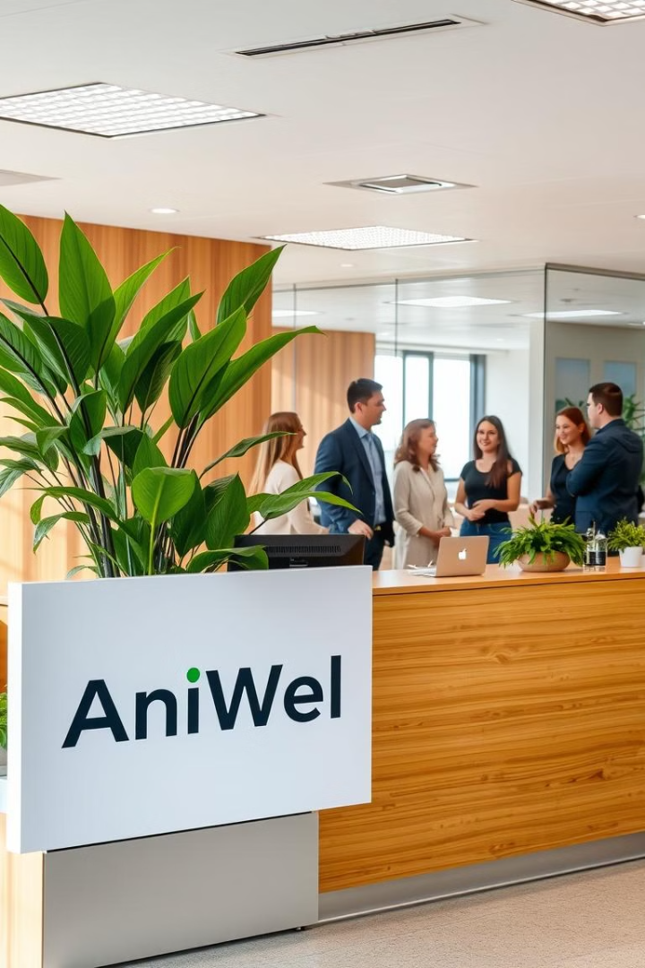
Contact Us
1
Phone number
2
Email address
3
Physical address
4
Social media links

Slide 8

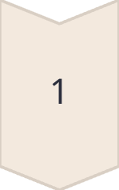
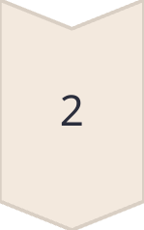
HTML and CSS Technology
HTML
HTML (HyperText Markup Language) is used to define the structure and content of the website.
CSS
CSS (Cascading Style Sheets) is used to style the appearance and layout of the website.

Slide 9



Design and Layout
User-Friendly
1
The website prioritizes user experience, making it easy to navigate and find relevant information.
Visually Appealing
2
A visually appealing and modern design that enhances the user experience.
Responsive Design
3
The website adapts seamlessly to different screen sizes and devices, ensuring a consistent experience across all platforms.

Slide 10
Responsive Design
Mobile-First
1
The website is designed with mobile devices in mind, ensuring optimal viewing and interaction on smaller screens.
Adaptive Layouts
2
The layout adapts to various screen sizes, ensuring optimal content display across devices.
Seamless Experience
3
A consistent and engaging user experience across different platforms, providing a seamless interaction.

